Slide 1
How to change the due date of a loan and send letter to patron after changing the calendar (using job Loans - Due Date Correction after Calendar Change)
Yoel Kortick
Senior Librarian

Slide 2
Introduction
Example before the job "Loans - Due Date Correction after Calendar Change" runs
Adding a message to the "Loan Status Notice" letter
Example after the job "Loans - Due Date Correction after Calendar Change" runs

Slide 3
Introduction

Slide 4
Introduction
After changing the calendar in Alma the loans which should have been due when the library was open (but is now closed) need to be changed to a later due date which will fall when the library reopens.
This is done via the job "Loans - Due Date Correction after Calendar Change".

Slide 5
Introduction
The job "Loans - Due Date Correction after Calendar Change" will not only change the due dates but also send a "Change Due Date" emails to users
The "Change Due Date" email to users will be sent if the "Loan Status Notice" letter is enabled.
A customized relevant message regarding why the due date was changed may be added to the letter.

Slide 6
Example before the job "Loans - Due Date Correction after Calendar Change" runs

Slide 7
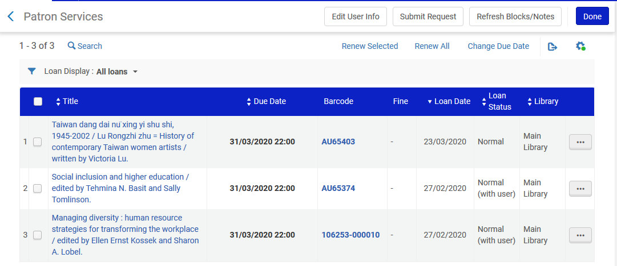
Example before the job "Loans - Due Date Correction after Calendar Change" runs
Patron Alicia Chen has three items from Main Library on Loan and due March 31, 2020

Slide 8
Example before the job "Loans - Due Date Correction after Calendar Change" runs
The staff need to unexpectedly close the Main Library from March 26 to April 15, 2020.
Therefore Alicia’s loans will be due when the library is closed.
The staff navigate to the Main Library opening hours via:
Configuration > Configuring Main Library > Fulfillment > Library Management > Opening Hours

Slide 9
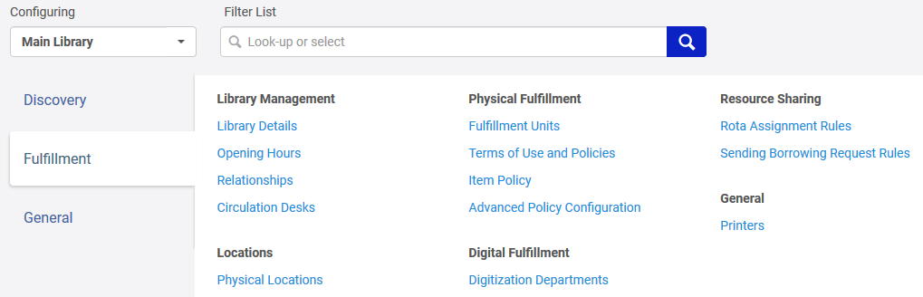
Example before the job "Loans - Due Date Correction after Calendar Change" runs

Slide 10
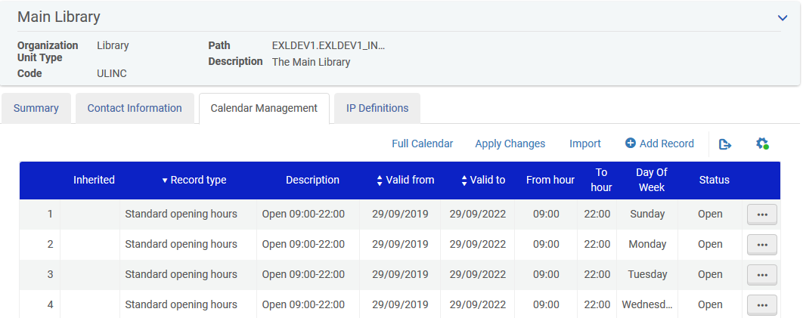
Example before the job "Loans - Due Date Correction after Calendar Change" runs
The calendar appears and the staff will add an exception to close the Main Library from March 26 to April 15, 2020.

Slide 11
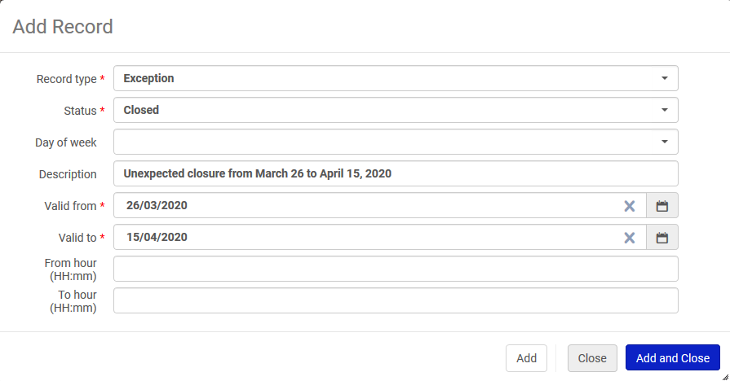
Example before the job "Loans - Due Date Correction after Calendar Change" runs
Here is the exception record

Slide 12
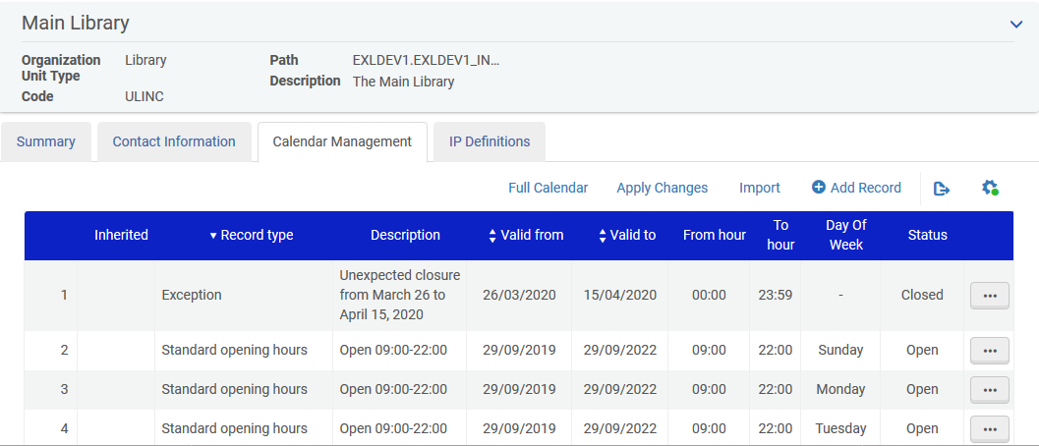
Example before the job "Loans - Due Date Correction after Calendar Change" runs
Here is the exception in the calendar. We click "Apply Changes"

Slide 13
Adding a message to the "Loan Status Notice" letter

Slide 14
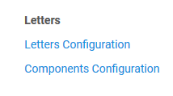
Adding a message to the "Loan Status Notice" letter
Now we will add a message to the "Loan Status Notice" letter.
Navigate to the letter via "Configuration > Configuring Institution > General > Letters > Letter Configuration"

Slide 15
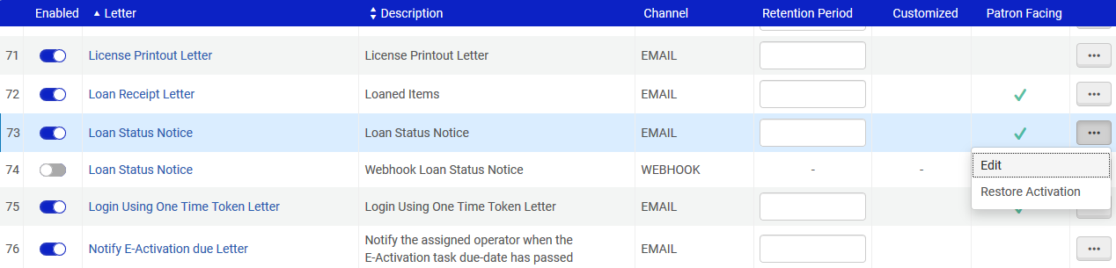
Adding a message to the "Loan Status Notice" letter
Scroll to the "Loan Status Notice" letter.
Make sure it is enabled and edit.

Slide 16
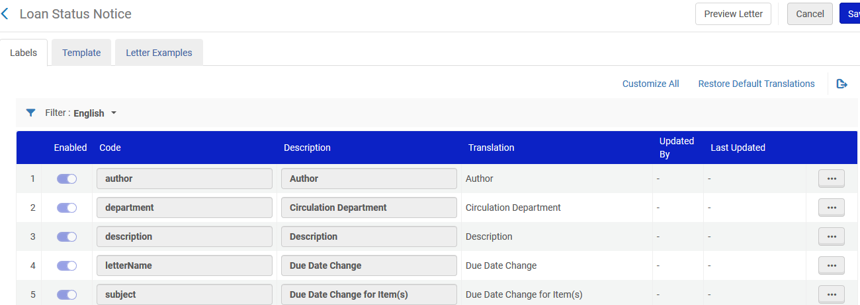
Adding a message to the "Loan Status Notice" letter
In the example here we will not edit the xsl template but rather change a label

Slide 17
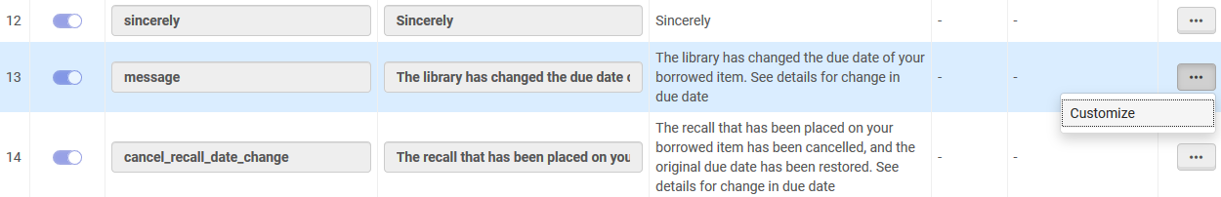
Adding a message to the "Loan Status Notice" letter
Here is the default message.
It states "The library has changed the due date of your borrowed item. See details for change in due date".
We will change it to "Due to unforeseen circumstances the library will be closed from March 26 to April 15, 2020 and therefore your due date has changed"

Slide 18
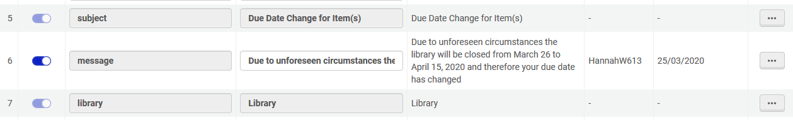
Adding a message to the "Loan Status Notice" letter
Now we have the message in the letter

Slide 19
Example after the job "Loans - Due Date Correction after Calendar Change" runs

Slide 20
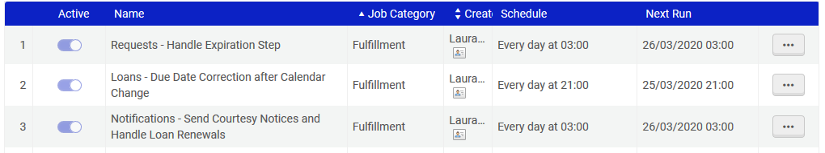
Example after the job "Loans - Due Date Correction after Calendar Change" runs
The job "Loans - Due Date Correction after Calendar Change" is scheduled to run every day at 21:00.
We can see this via "Admin > Manage Jobs and Sets > Monitor Jobs"

Slide 21
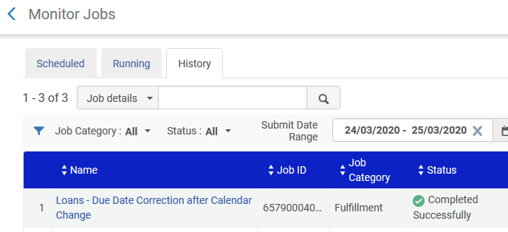
Example after the job "Loans - Due Date Correction after Calendar Change" runs
The job "Loans - Due Date Correction after Calendar Change" has run and completed successfully

Slide 22
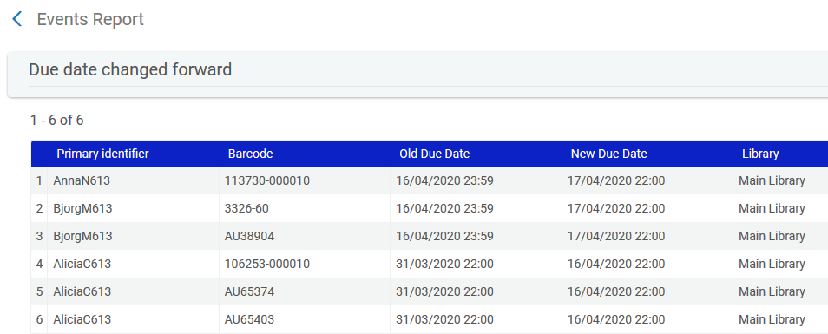
Example after the job "Loans - Due Date Correction after Calendar Change" runs
In the report we can see that Alicia’s loans moved forward to April 16
Loans changed to be due April 16 because library is closed from March 26 to April 15

Slide 23
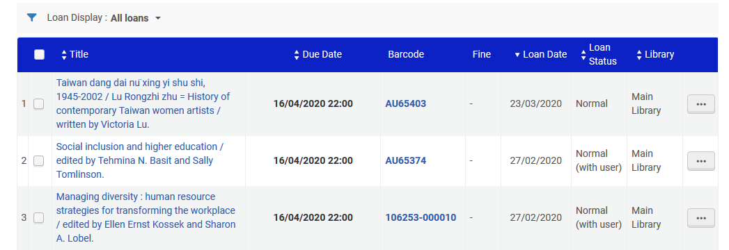
Example after the job "Loans - Due Date Correction after Calendar Change" runs
In Alma we can see that Alicia’s loans moved forward to April 16

Slide 24
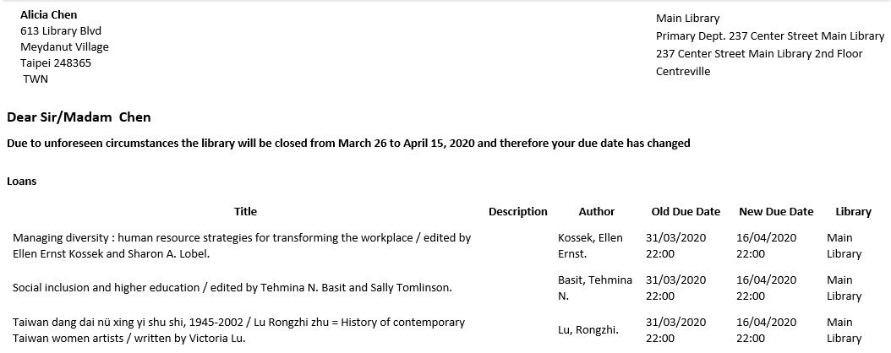
Example after the job "Loans - Due Date Correction after Calendar Change" runs
Alicia also received a letter that the due dates were changed and it includes the message we defined.

Slide 25
Thank you!
xxx@exlibrisgroup.com

